Slide 1
CANIS: Curated AI-ready Network telescope datasets for Internet Security PI: Ka Pui (Ricky) Mok (CAIDA/UC San Diego) Co-PIs: kc claffy (CAIDA/UC San Diego)
CAIDA/UCSD hosts UCSD Network Telescope (UCSD-NT), a cyberinfrastructure to capture unsolicited traffic sent to a large unused IPv4 address space
The address space is owned and managed by ARDC, a non-profit organization supporting the amateur radio community
Data integrity issues arise as ARDC increases the utilization of the address space for various experimentation and use cases
Forthcoming ACM SIGCOMM paper* explains the problem in details
*Alexander Männel, Jonas Mücke, kc claffy, Max Gao, Ricky K. P. Mok, Marcin Nawrocki, Thomas C. Schmidt, and Matthias Wählisch, "Lessons learned from operating a large network telescope", ACM SIGCOMM, 2025.

Slide 2
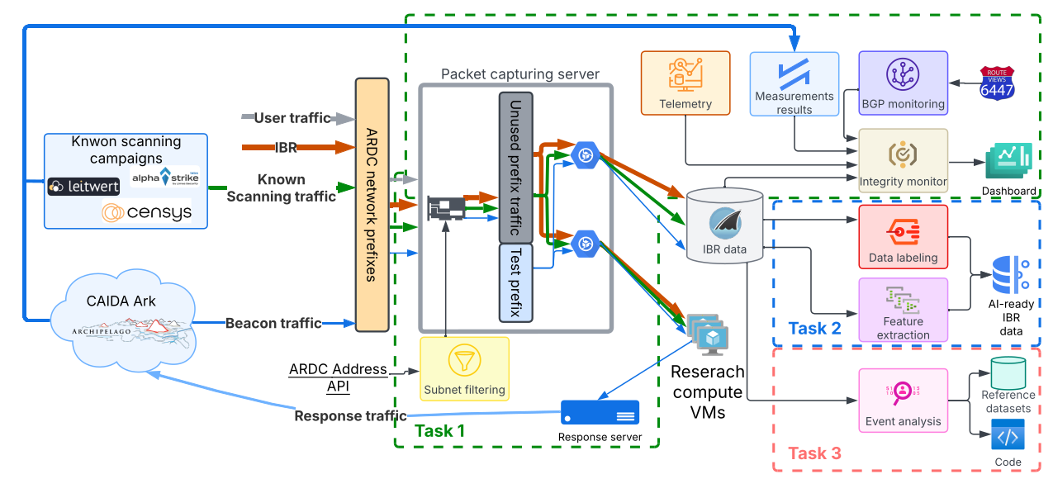
CANIS: Curated AI-ready Network telescope datasets for Internet Security PI: Ka Pui (Ricky) Mok (CAIDA/UC San Diego) Co-PIs: kc claffy (CAIDA/UC San Diego)
Need For Integrity, Provenance, and Authenticity (IPA)
Increasing complexity of UCSD-NT threatens IPA of the data
AI/ML tools require high-quality labeled datasets for training & evaluation
Approach to Achieve IPA in AI Datasets
Strengthen telemetry of UCSD-NT, transparency to data consumers
Create open-source labeling functions using traffic fingerprints
CANIS is a suite of modules to improve the UCSD-NT infrastructure for acquisition, processing, & analytics of cybersecurity research workflows.
Benefits to Scientific Cyberinfrastructure
Provide high-quality data that informs cyber threat intelligence to enhance security of scientific cyberinfrastructure
improve performance (speed) and accuracy of event detection
Risks Versus Potential For Advances
Not all malicious traffic has known fingerprints for labeling
Obtaining ground-truth for reference datasets is a challenge
Evaluating and Demonstrating IPA
Metrics of success: # of data users, publications, and AI models
Publicly available data on CAIDA website, object storage (accessible from SDSC Expanse), Grafana dashboards
Host tutorials to demonstrate the use of datasets for AI applications
Programmatic Details
3-year project started on October 2025
Led by CAIDA/UC San Diego
Unfunded collaborators at TU Dresden, U Twente
This material is based upon work supported by the National Science Foundation under Grant No. 2531134

Slide 3
Dataset challenges
Growing size of data (~150GB per hour)
Restricted data
On-premise data access
Data + Compute
Multiple modes/formats of data for different use cases/AI software stacks
Exploring the use of OSDF

